Slide 1
SPACING
Hamza Ahmed, Design section TA

Slide 2
What’s wrong with this UI?

Slide 3
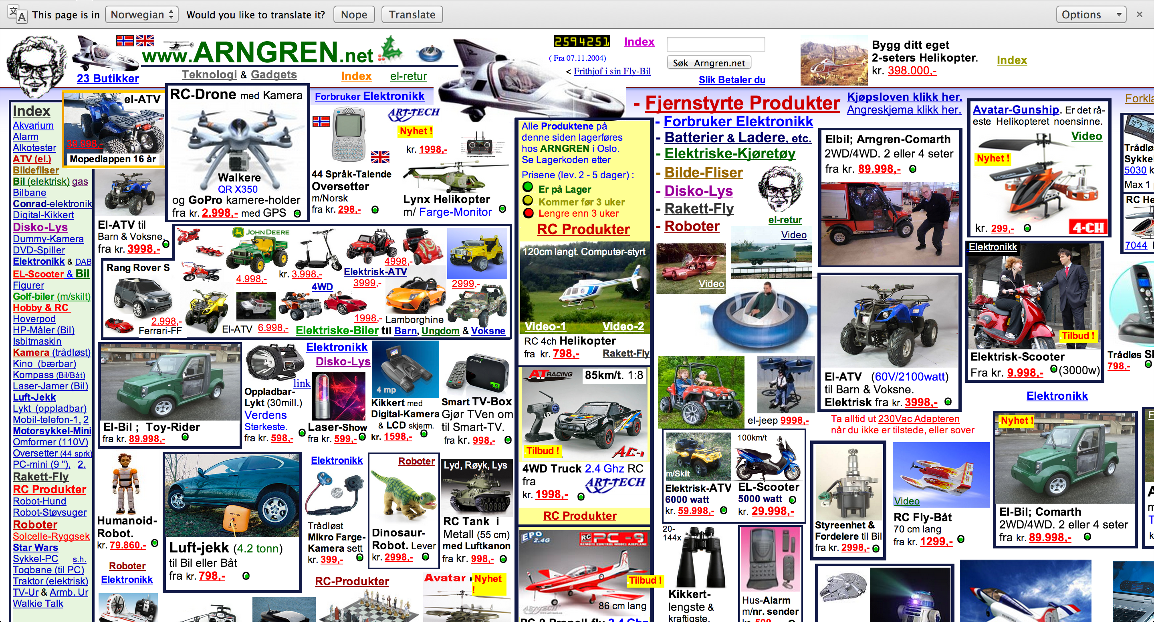
Arngren

Slide 4
“Cluttered”

Slide 5
Spacing
Spacing makes or break a user interface
Not a good idea to stuff in as much information as possible in a given space
A common argument: “Users won’t see that much content”
A counterargument: Quality of UX > Quantity of UX
Spacing establishes hierarchy of information
Direct user’s attention to a piece of information

Slide 6

Use of spacing in an Apple Store

Slide 7
Spacing
Positive Space: Space filled up by content
Negative Space (White Space): An empty space
Space between positive space (UI elements)
Helps to define content in a positive space (Creates emphasis)

Slide 8
Macro-level spacing
Use Macro-level Spacing to give structure to your interface
Ensure that there is a significant amount of “room to breathe” between each UI element
Give more room (white space) for a UI element to give it more emphasis
Give less room to reduce emphasis

Slide 9
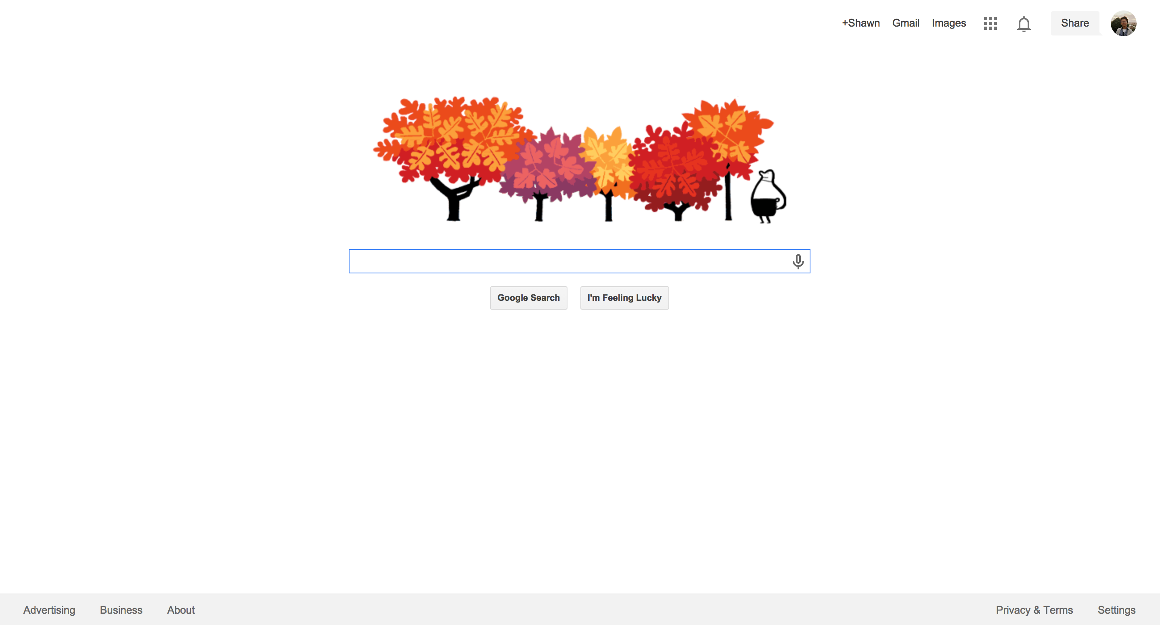
Google

Slide 10
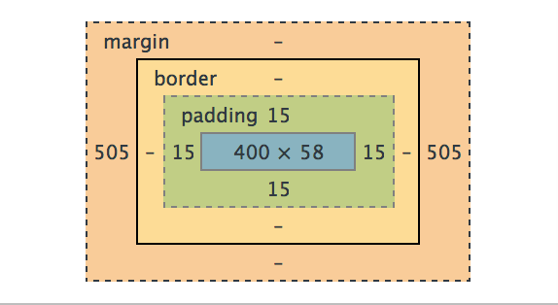
Macro-level spacing in CSS
CSS Box Model allows you to accomplish spacing in web design

Slide 11
Padding: Inner Spacing
Margin: Outer Spacing

Slide 12
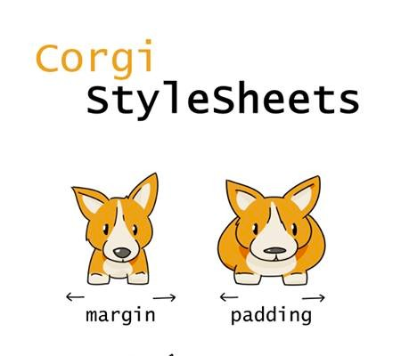
Padding vs Margin

Slide 13
Macro-level spacing in CSS
Each UI element should have some padding in order to draw emphasis & define its purpose.
When to use padding:
If spacing deserves to be in its own element (i.e. to space out the content from the edges of the element)
Ex.: Button
When to use margin: If spacing deserves to be between elements (give separation for different elements)
Ex.: Separation between articles

Slide 14
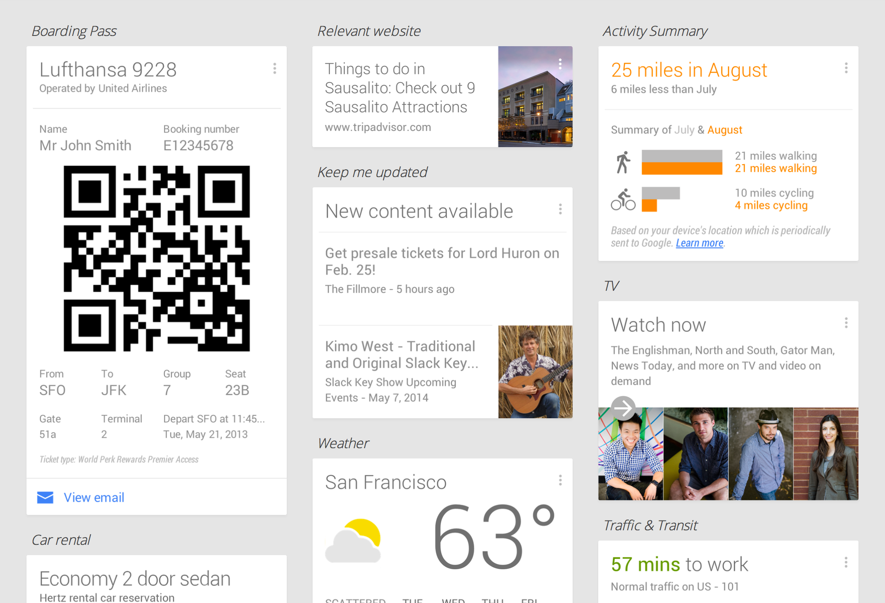
Padding vs. Margin

Slide 15
Micro-level Spacing
Use micro-level spacing to increase legibility of the text
Accomplished through “line spacing” and “letter spacing”
Extremely useful for text-heavy websites like blogs

Slide 16
Line-height CSS property makes or breaks the legibility of text
Micro-level spacing in CSS

Slide 17
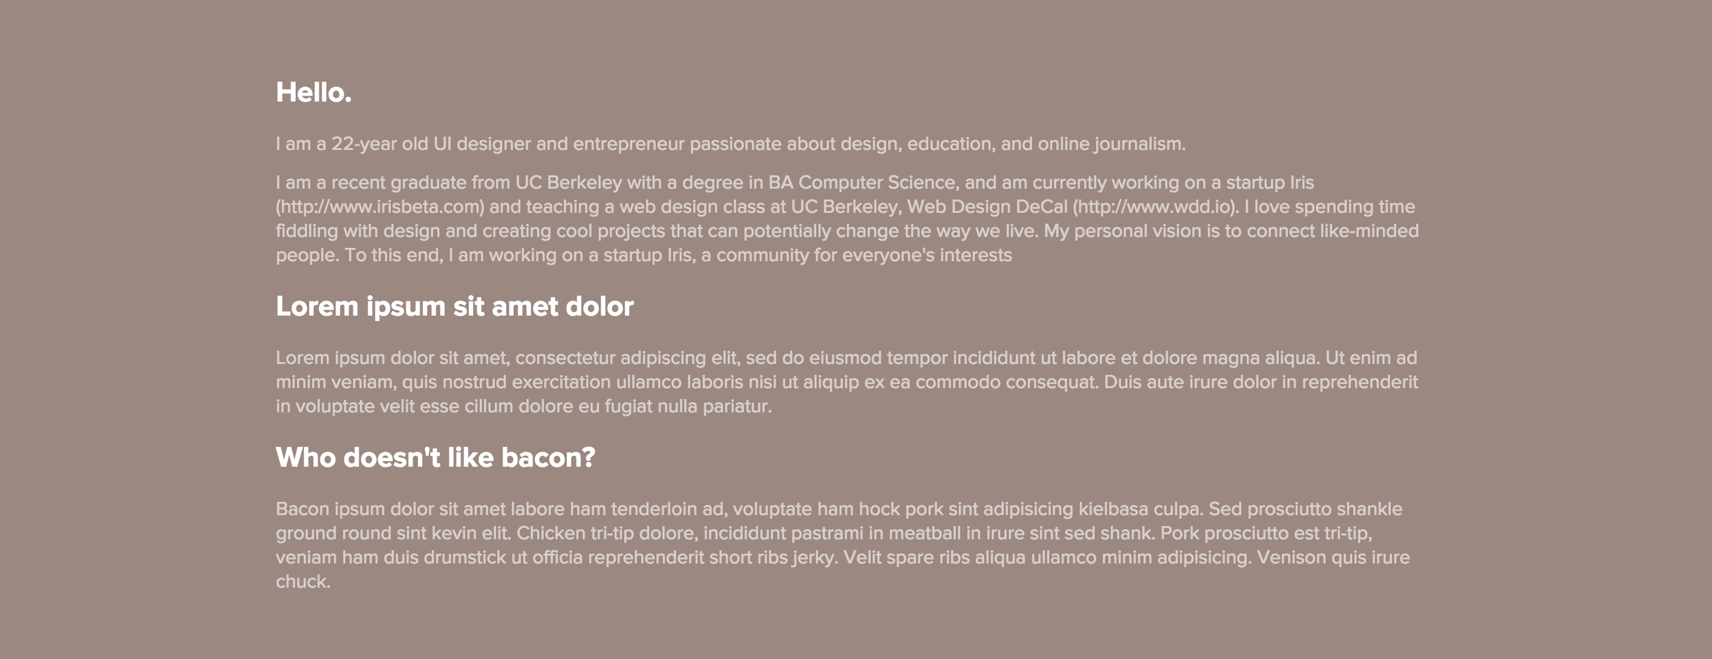
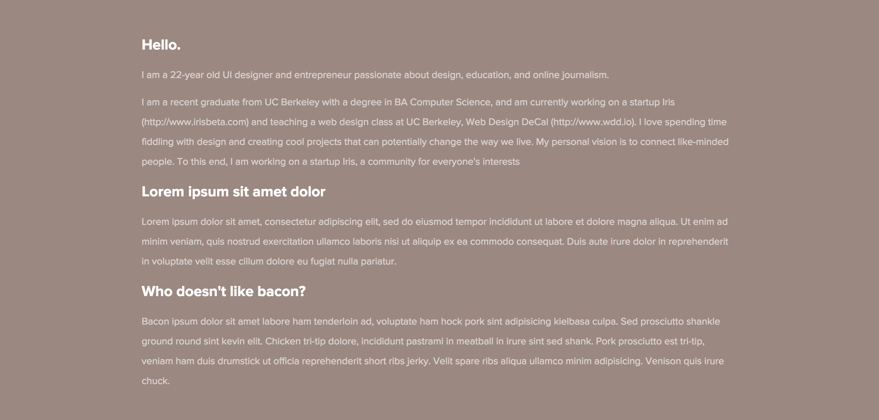
Line-height: normal
Line-height: 32px
Effect of line height

Slide 18
Paragraph width
When the width of your paragraph gets too long, it becomes hard to read.
Usually 640px – 720px is the limit of “legible” paragraph.
Use “containers” to restrict the width of your text

Slide 19
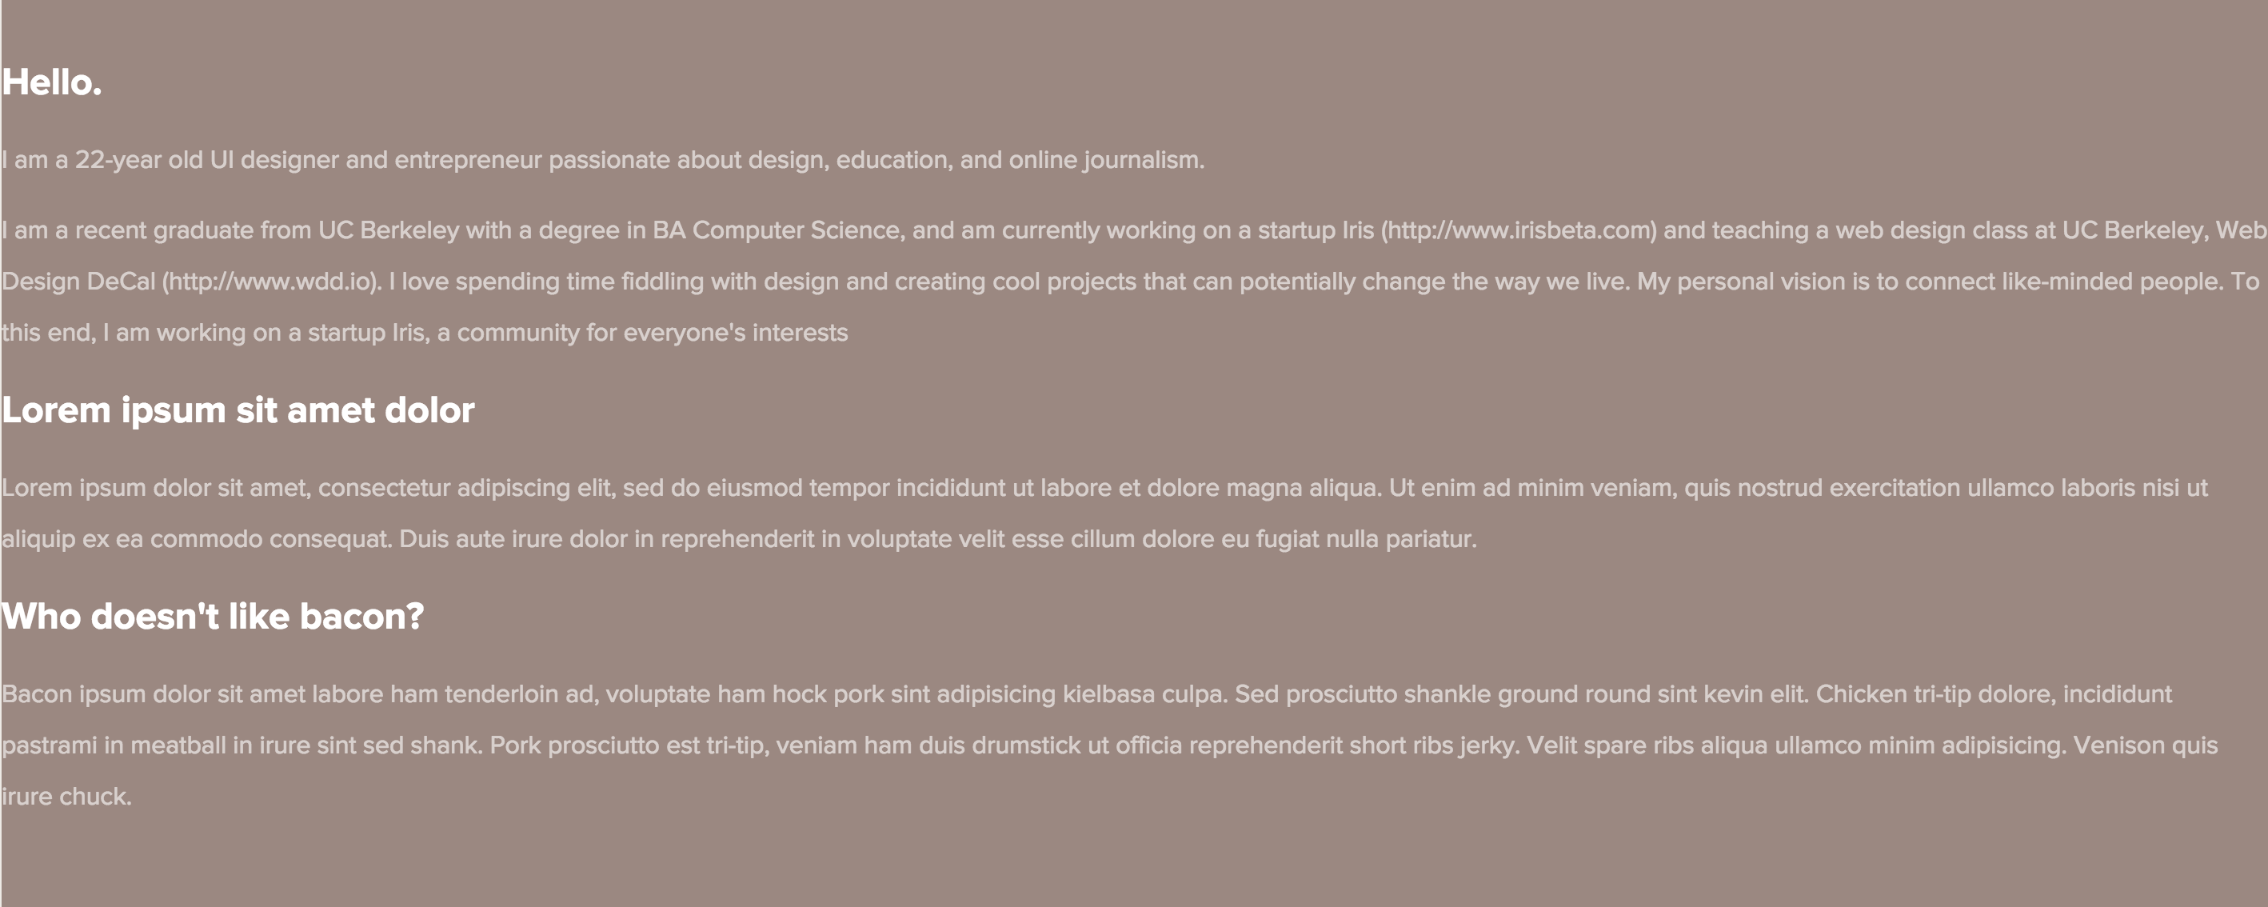
Paragraph width: 100%
Paragraph width: 960px
Effect of setting a paragraph width

Slide 20
Keep your metrics consistent
Padding around an element should be equal.
Use simple multiples for your spacing metrics (and for other metrics as well)
Ex: 20px padding & 10px margin (multiples of 10)
Ex: 12px padding & 16px font-size & 32px line-height

Slide 21
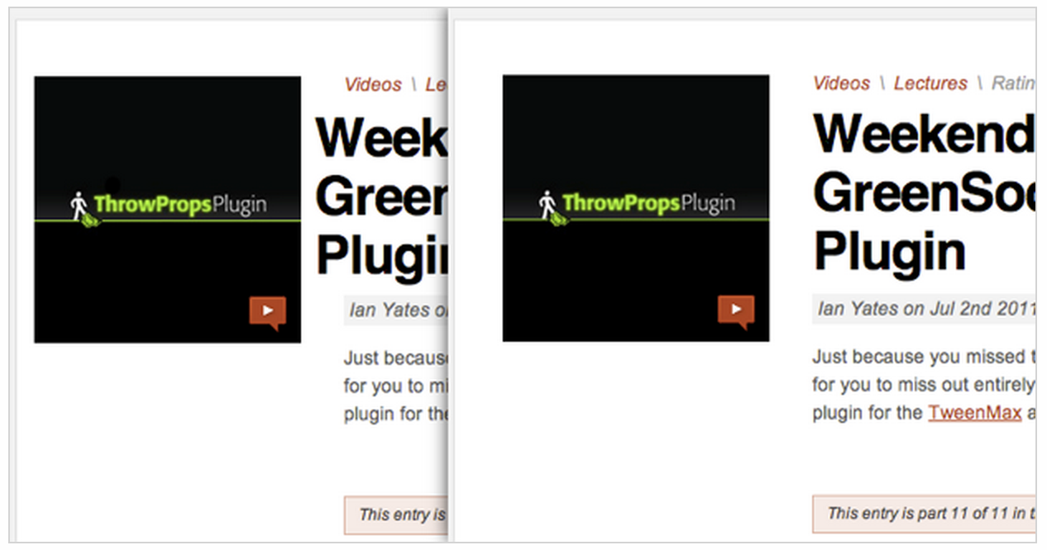
Keep your spacing consistent

Slide 22
Simple not barren
It’s important not to overuse spacing
Run into issues where your UI looks “barren”
There is no golden rule for maintaining the balance
A lot of this comes from experience & looking at other designs
Use white-space judiciously depending on the purpose of your website.
Application: Less white-space ( ~ 20px padding )
Promotional: More white-space ( ~ 60px padding )

Slide 23
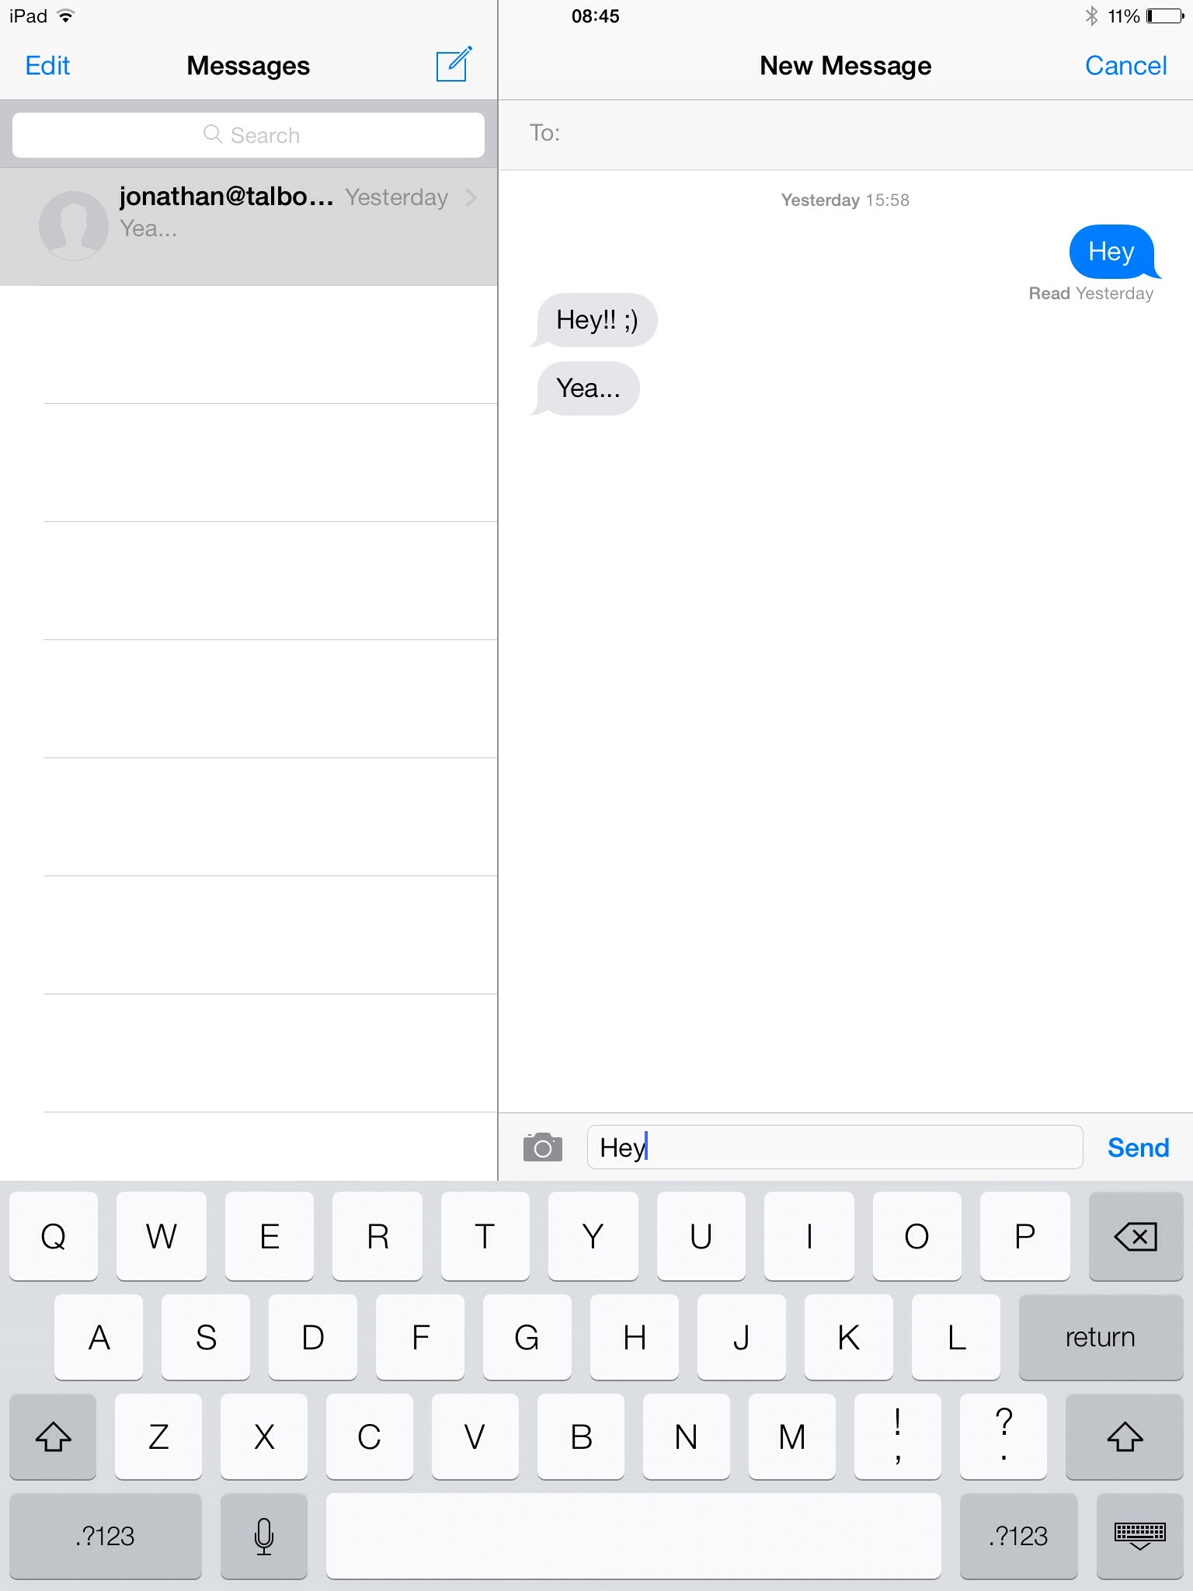
Barren UI example

Slide 24
Margins & Paddings that are too large breaks relationships between elements
Why barren?

Slide 25
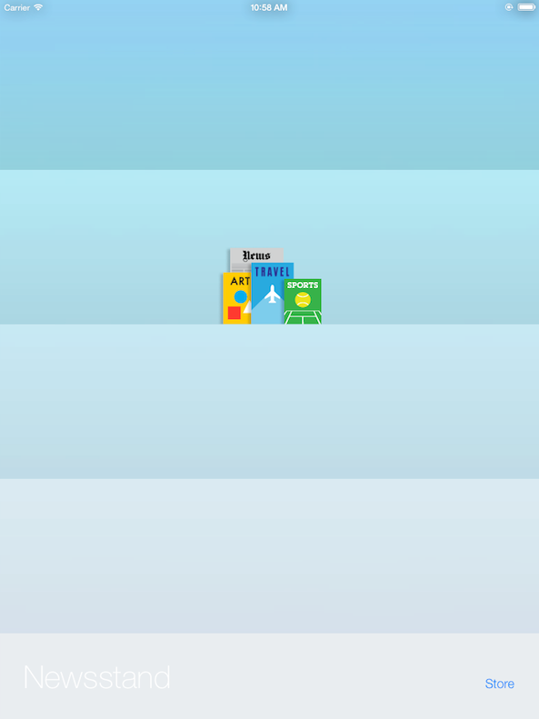
Barren UI example

Slide 26
Content is simply floating in the middle of nowhere
Why barren?

Slide 27
Review
Macro-level spacing
Gives an element a structure & “room to breathe”
Padding: Spacing within an element
Margin: Spacing between elements
Micro-level spacing
Influences the legibility of text
Make sure your spacing makes your UI simple, but not barren.

